Slide 1


Computational MRI
Parallel Imaging III
Non-Cartesian Imaging and Iterative Reconstruction

Slide 2
Overview
Non-Cartesian parallel imaging
Iterative image reconstruction
The conjugate gradient algorithm and CG-SENSE

Slide 3
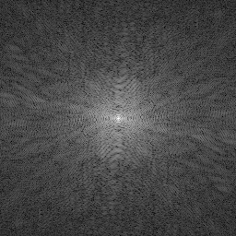
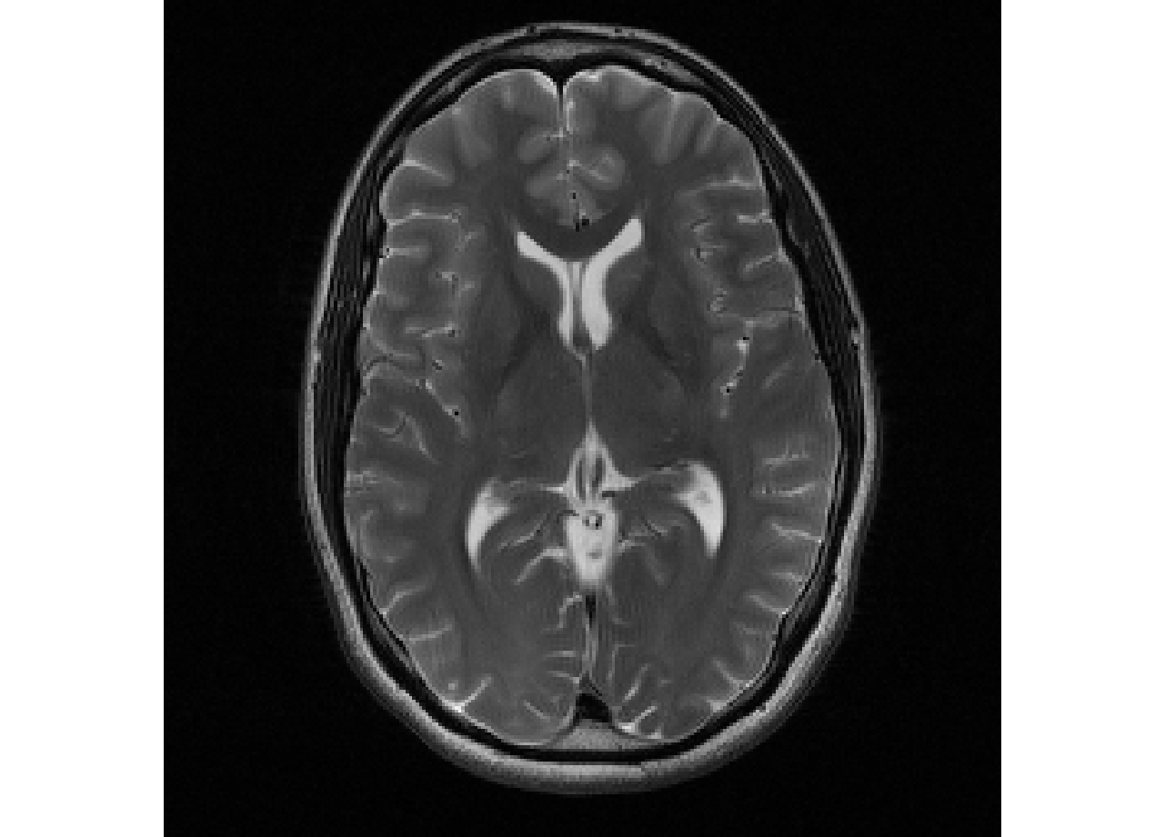
Cartesian subsampling
IFT
→

Slide 4
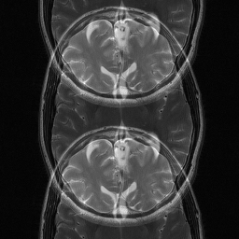
Cartesian subsampling
IFT
→

Slide 5
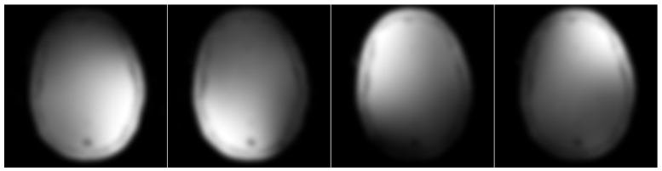
Cartesian SENSE
T2 weighted brain scan
4-Channel receive coil
Sensitivities are known
Pruessmann et al., MRM 42: 952-962 (1999)

Slide 6
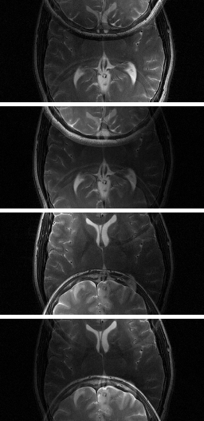
Cartesian SENSE
Coil 1
Coil 2
Coil 3
Coil 4

Slide 7
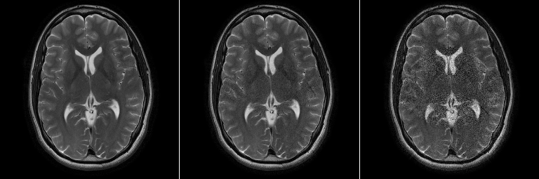
Parallel Imaging: SENSE
SENSE, R=2
SENSE, R=3
SENSE, R=4

Slide 8
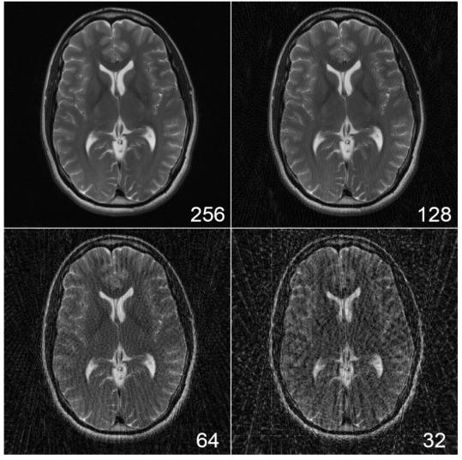

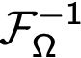
Radial Subsampling
→
R=1
R=8
Different structure of aliasing

Slide 9
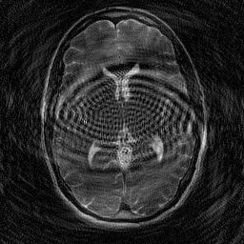
Spiral Subsampling
→
Different structure of aliasing

Slide 10
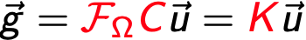
Building the encoding operator
Discretization
Forward operator,
encoding matrix

Slide 11
Image reconstruction as inverse problem
Encoding: linear system of equations
Reconstruction:
Solution of the system of equations
Inversion of the encoding matrix

Slide 12
Inversion of the encoding matrix
Direct methods: Pseudoinverse:
Matrix K can become very large!
Use iterative methods
Gradient descent
Conjugate Gradient algorithm
N²
ncnk
ncnk×N²
Magnus R and Stiefel E: Journal of Research of the National Bureau of Standards 49 (6) (1952)
Pruessmann et al., MRM 46: 638-651 (2001)

Slide 13
Iterative reconstruction
Given:
Forward Operator:
Measured k-space data:
Forward problem
Iterative reconstruction

Slide 14
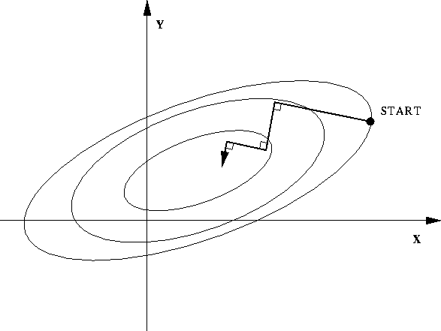
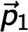
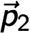
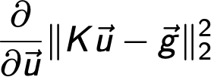
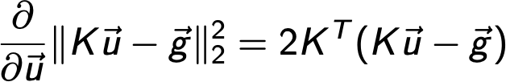
Iterative optimization: Gradient descent
Steepest descent
Exercise :-)

Slide 15
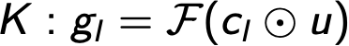
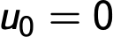
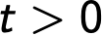

GD implementation (exercise)

Slide 16
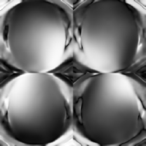
Exercise example
T2 weighted brain scan
3T System
4 channel head coil
TSE: Sequence parameters:
TR 5000ms
TE 99ms
Turbo Factor 10
Matrix Size 256x256
In Plane Resolution 0.9mmx0.9mm
Slice Thickness 4mm

Slide 17
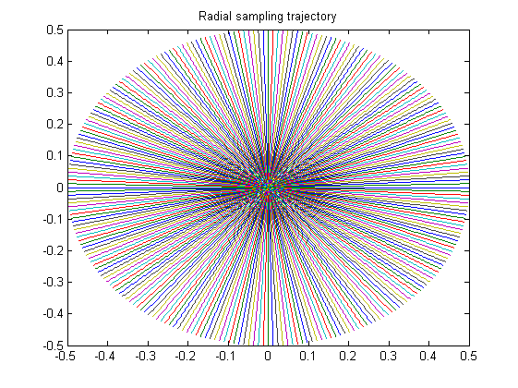
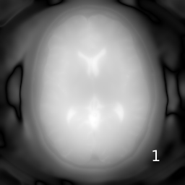
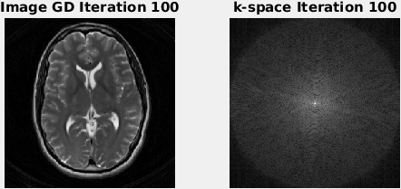
GD radial trajectory, 128 projections, R=2

Slide 18
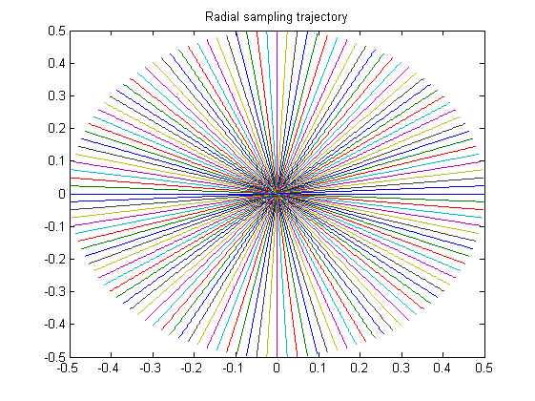

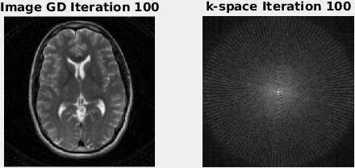
GD radial trajectory, 64 projections, R=4

Slide 19
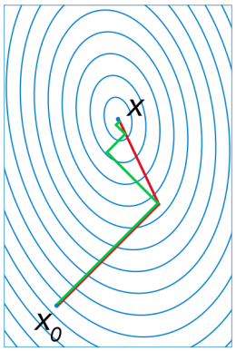
The conjugate gradient method
Source: Wikipedia
Minimize in subspace spanned by search directions that are K orthogonal (conjugate):
Converges to exact solution in n steps (n is matrix size)
n=2 quadratic form
Gradient descent (red)
Conjugate gradient minimization (green)

Slide 20
The conjugate gradient method
Residual
CG search direction
Update step
Step length

Slide 21
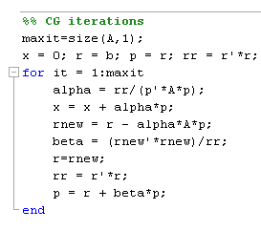
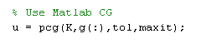
The conjugate gradient method
Exact solution: Interpretation as direct method
In practice: Used as iterative method
Unstable to perturbations, e.g. noise
Required tolerance usually achieved after it<<n
Very easy to implement (≈10 lines in Matlab, ≈10 minutes of work)
Implementations for Matlab, Numerical Recipes etc.

Slide 22
CG on the normal equations and preconditioning
Requirement: K symmetric and positive definite
CG on the normal equations
Preconditioning: „Modify equation such that right hand side is approximate solution“
Improve condition number
with
and

Slide 24
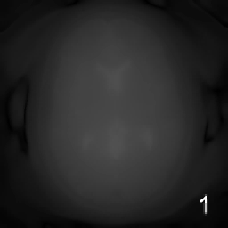
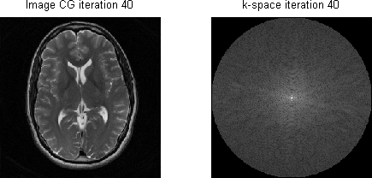
CG radial trajectory, 128 projections, R=2

Slide 25
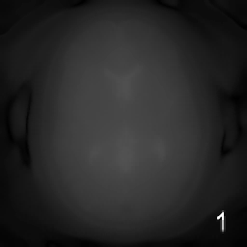

CG radial trajectory, 64 projections, R=4

Slide 26
GD-SENSE
CG-SENSE
128 projections
64 projections

Slide 27
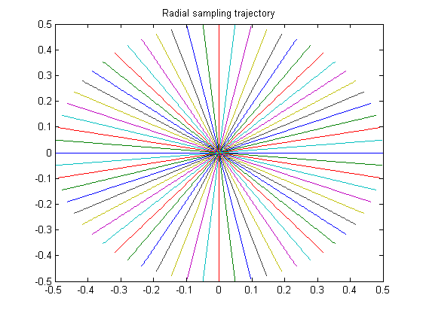
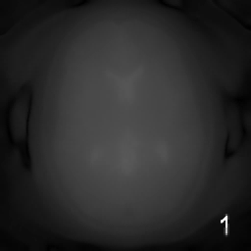

CG radial trajectory, 32 projections, R=8

Slide 28
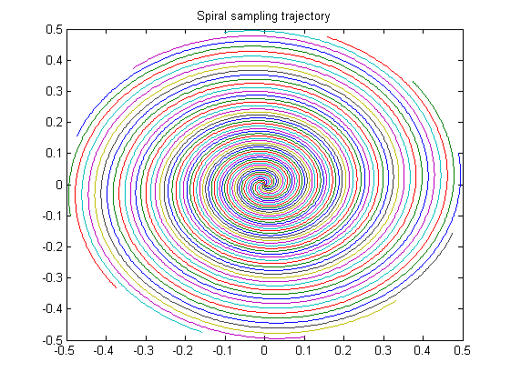
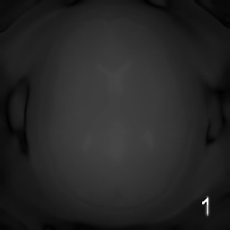
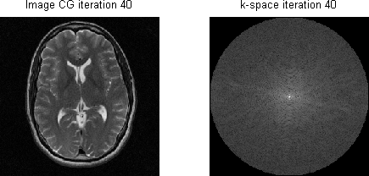
CG spiral trajectory, 12 interleaves, R≈4

Slide 29
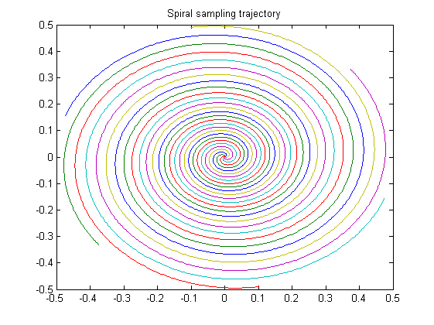
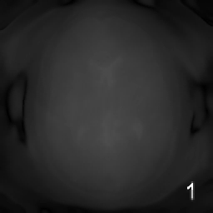
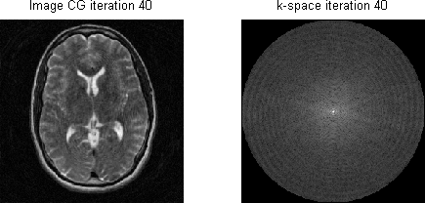
CG spiral trajectory, 6 interleaves, R≈8

Slide 30
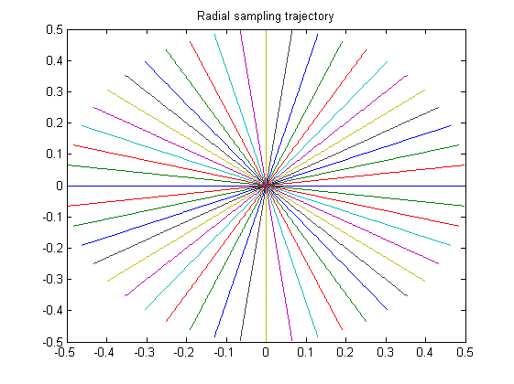
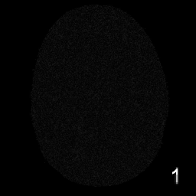
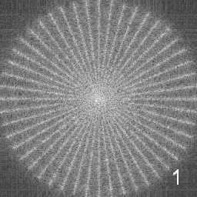
Noise propagation: Radial trajectory, 24 projections

Slide 31
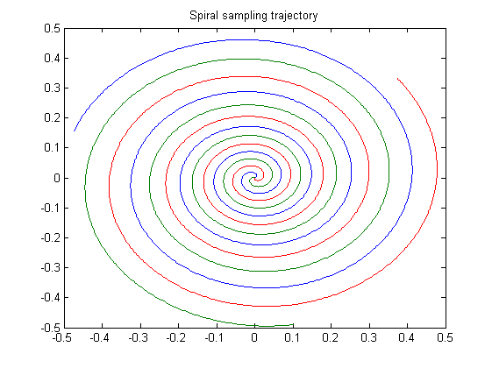
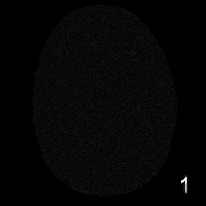
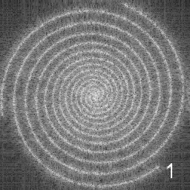
Noise propagation: Spiral trajectory, 3 interleaves

Slide 32


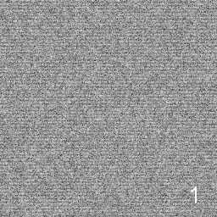
Noise propagation: Cartesian, R=4

Slide 33
Acceleration is limited
Acceleration factor approaches number of coils
Severe noise amplification
Residual artifacts
Ill conditioning of the encoding matrix
Regularize the inversion:
CG SENSE: Stopping after a certain amount of iterations
Regularization constraints tailored to imaging problem

Slide 34
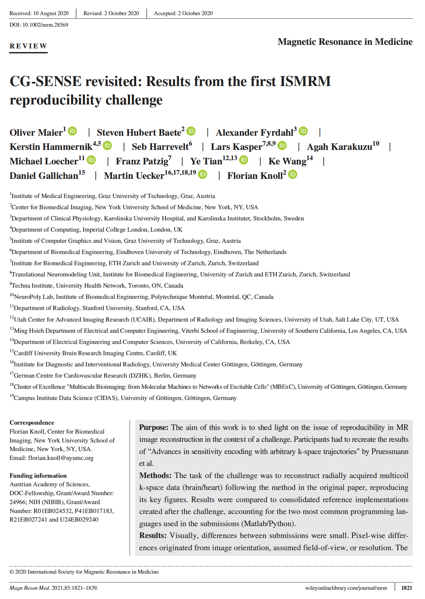

Slide 35


Slide 36
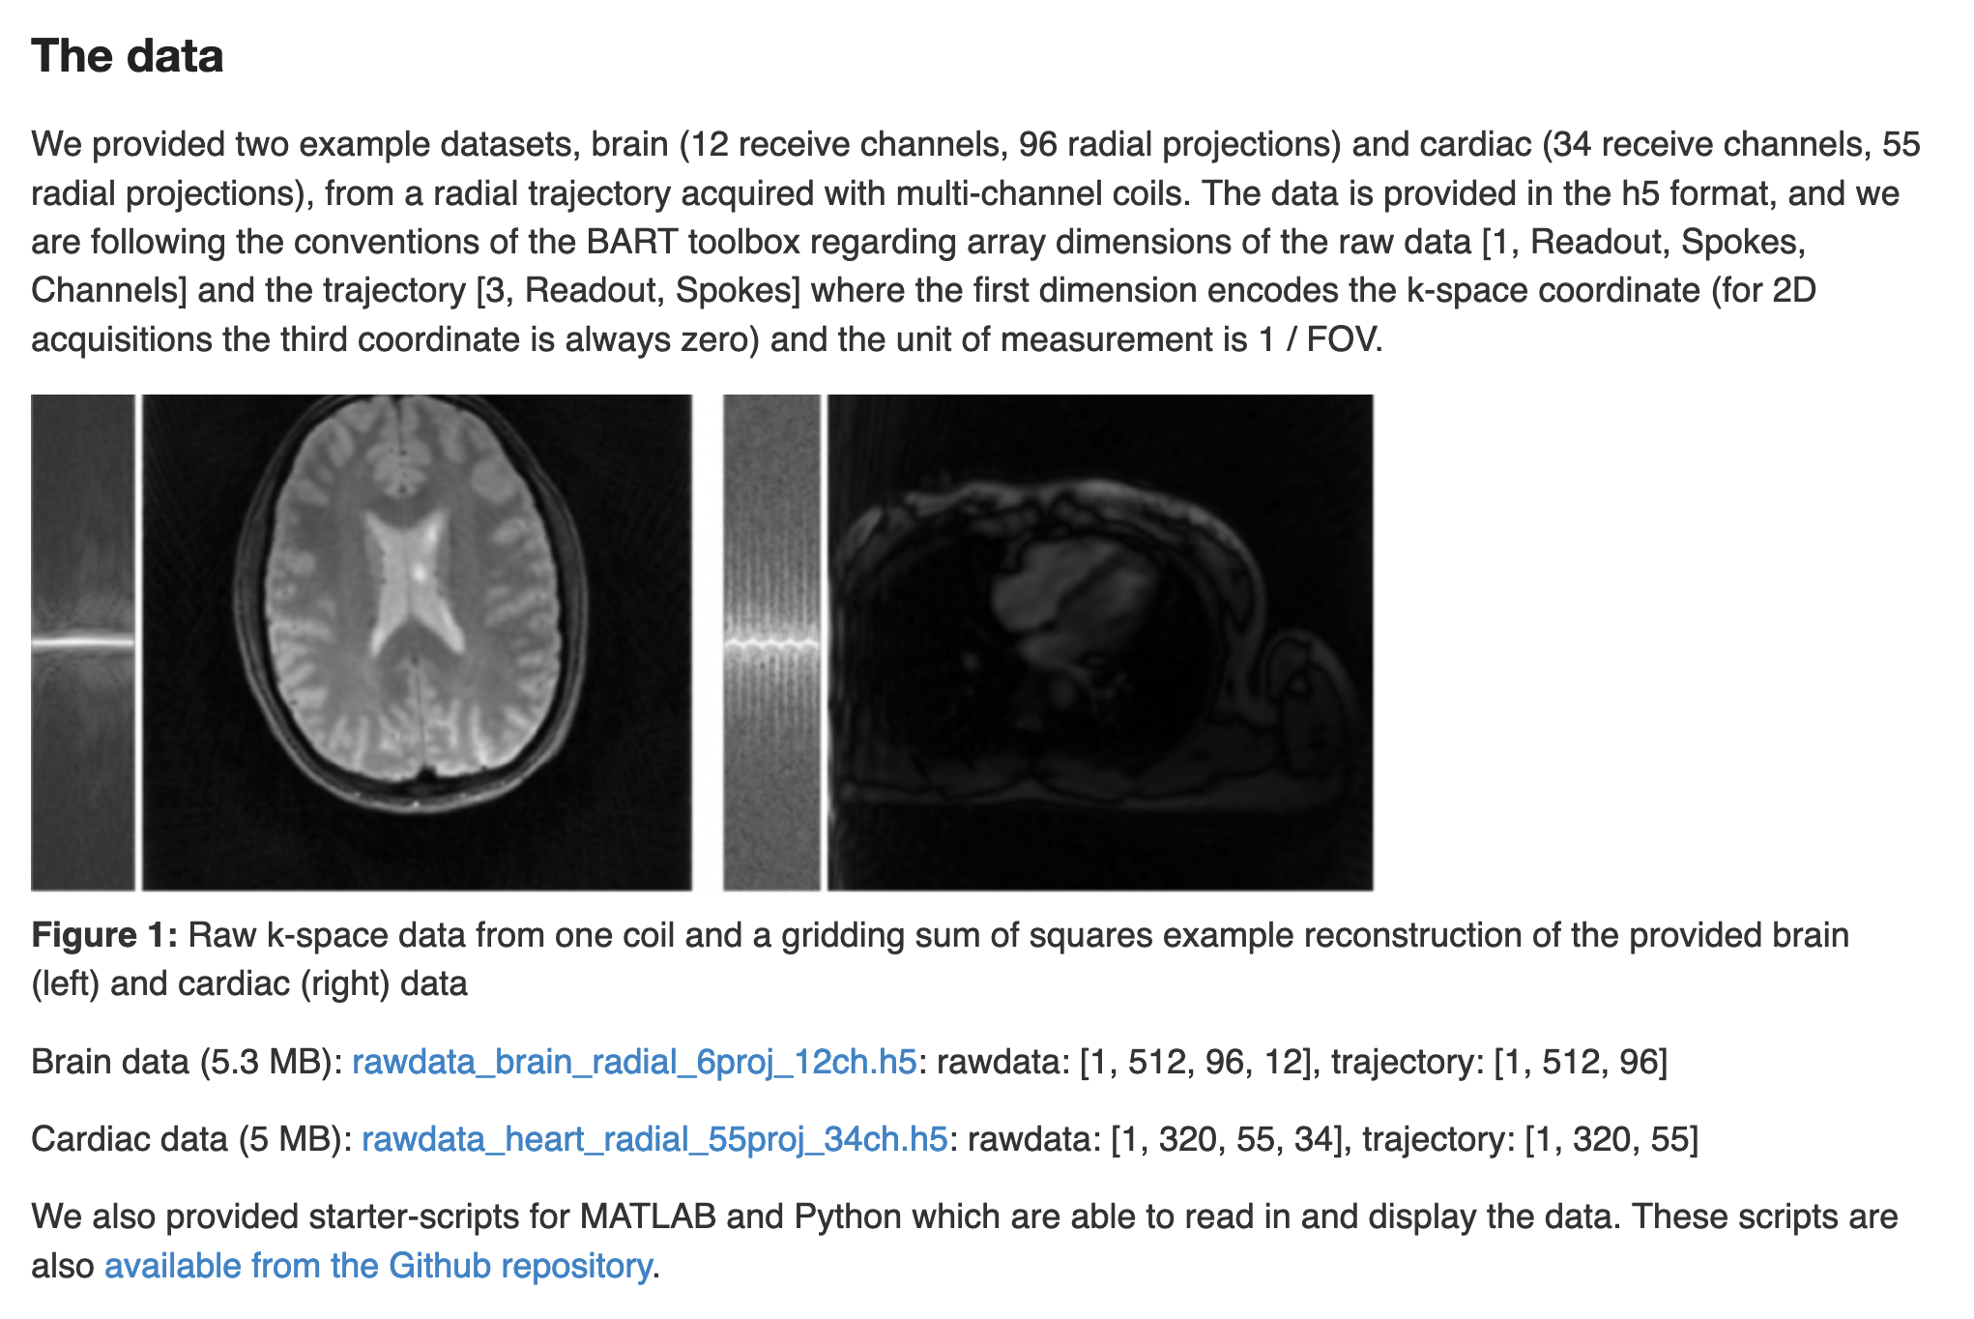

Slide 37
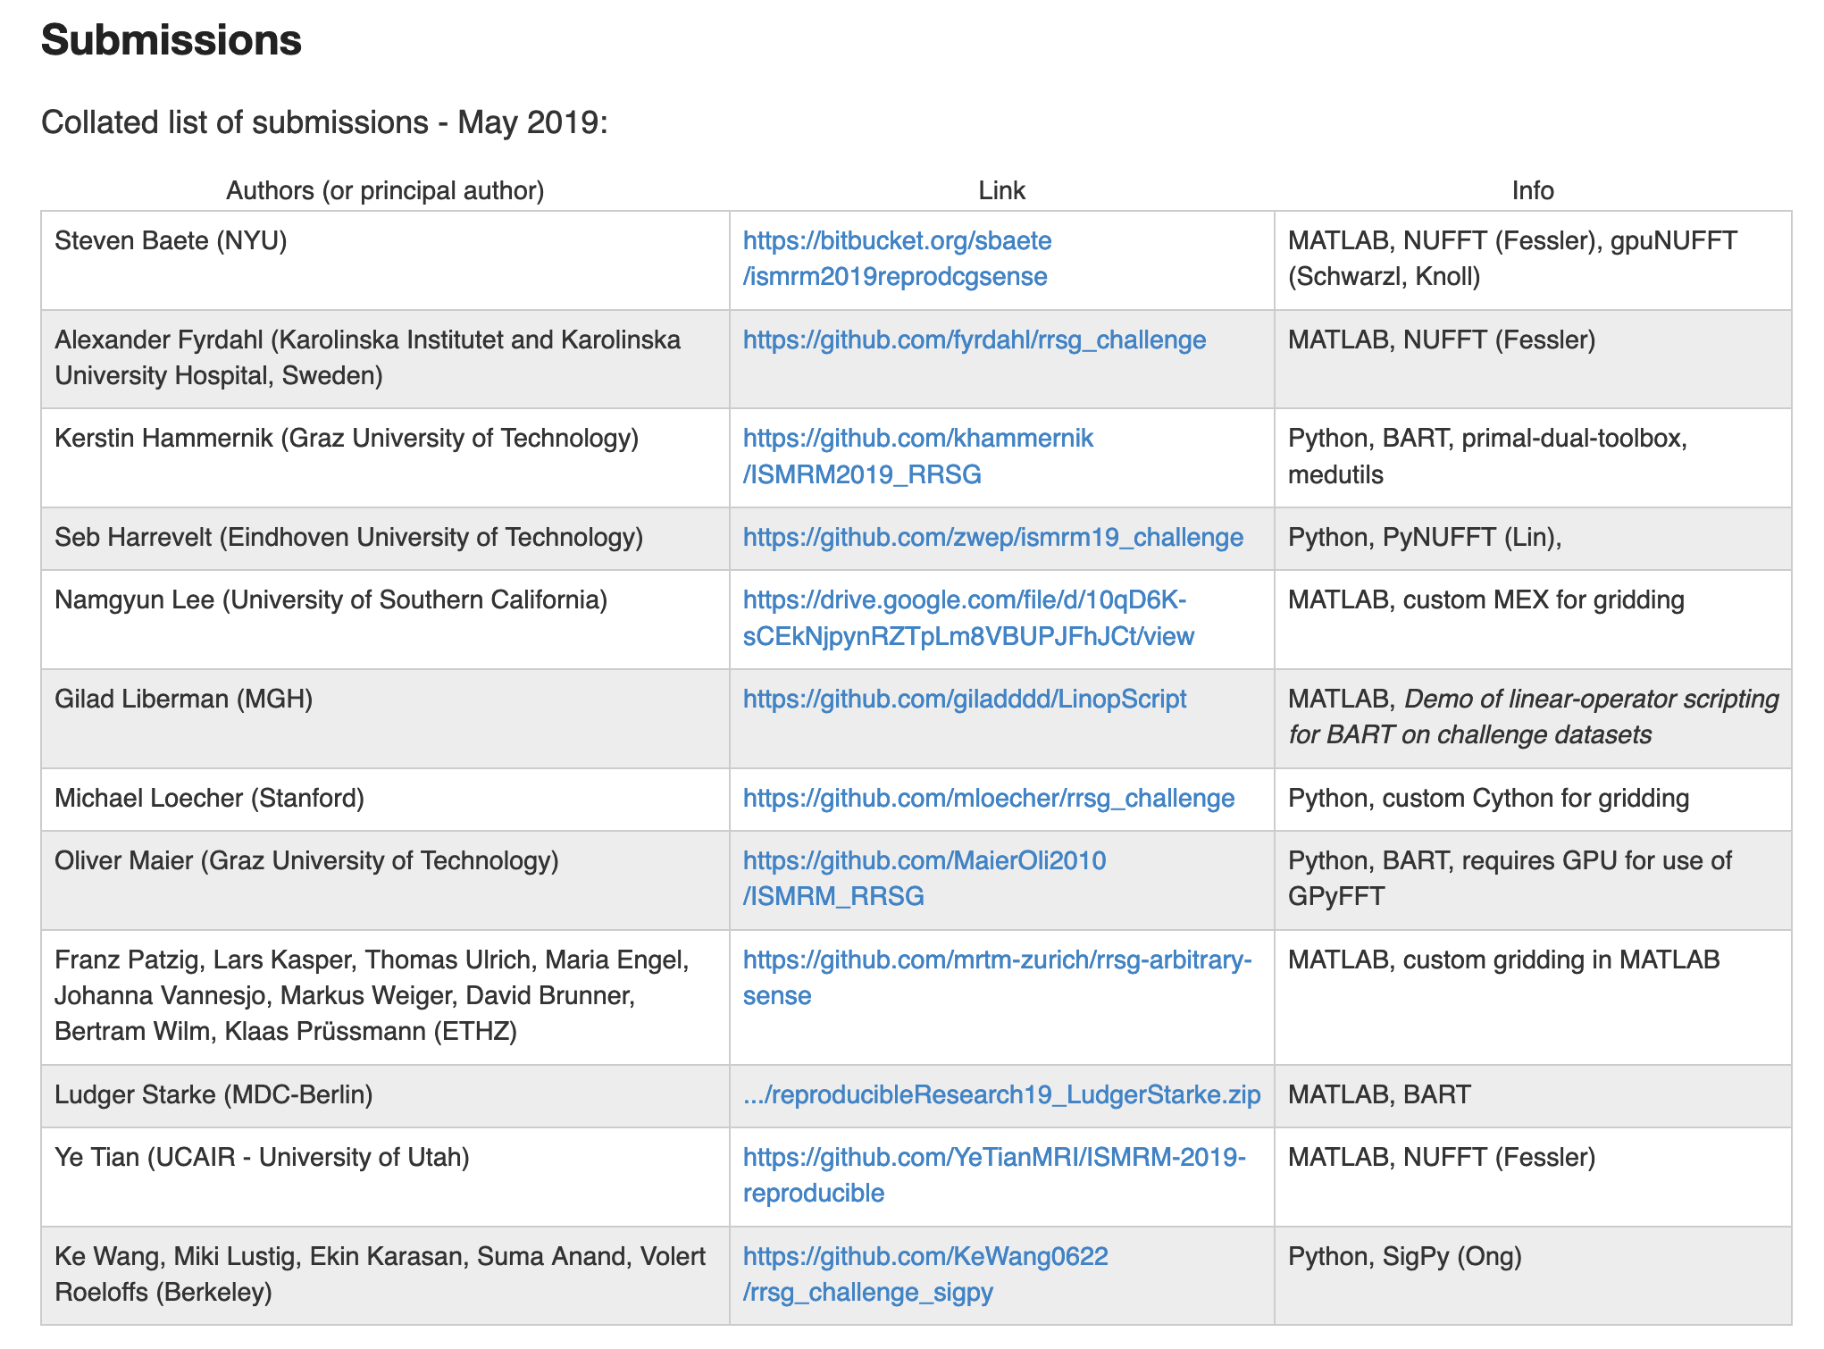

Slide 39
Consolidated Python implementation
Consolidated Matlab implementation

Slide 40
Summary
Aliasing for non-Cartesian subsampling
Iterative reconstruction: GD, and CG
Convergence behavior
Noise propagation

Slide 41
Challenge submissions and data: https://ismrm.github.io/rrsg/challenge_one/
Reference implementations, evaluation scripts: https://github.com/ISMRM/rrsg_challenge_01
Supplementary spiral brain and radial cardiac data: https://doi.org/10.5281/zenodo.3975887

Slide 42
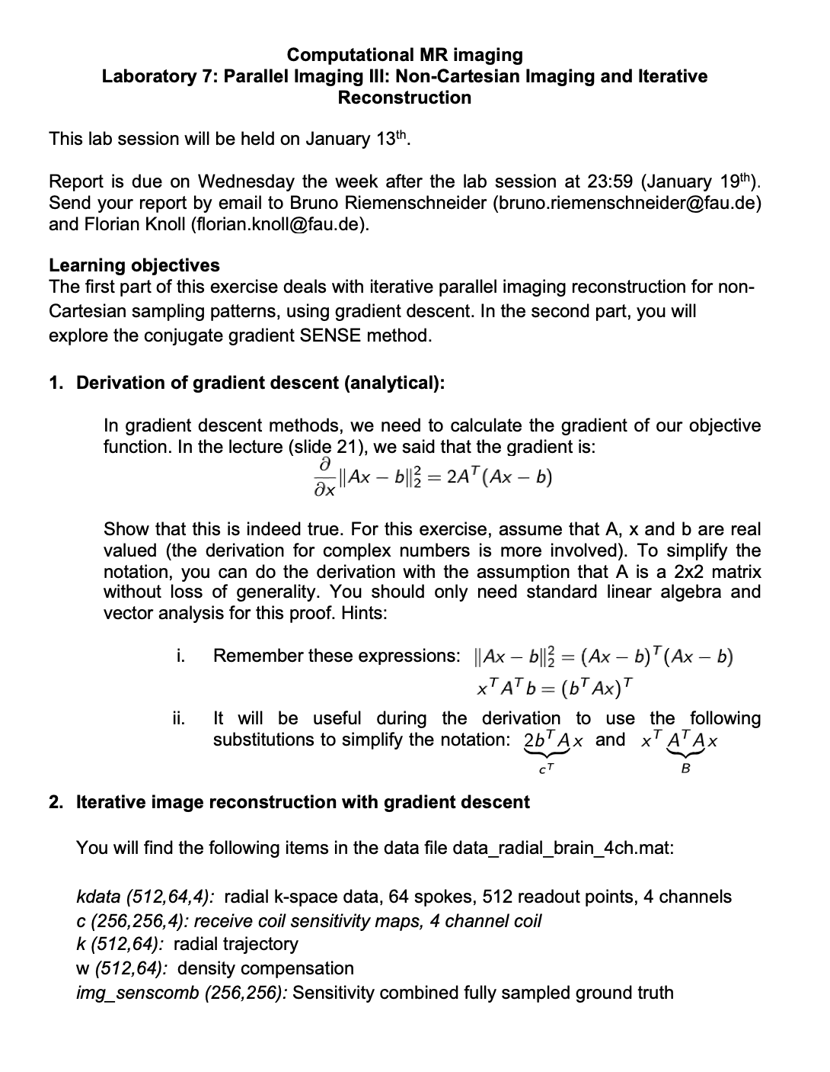
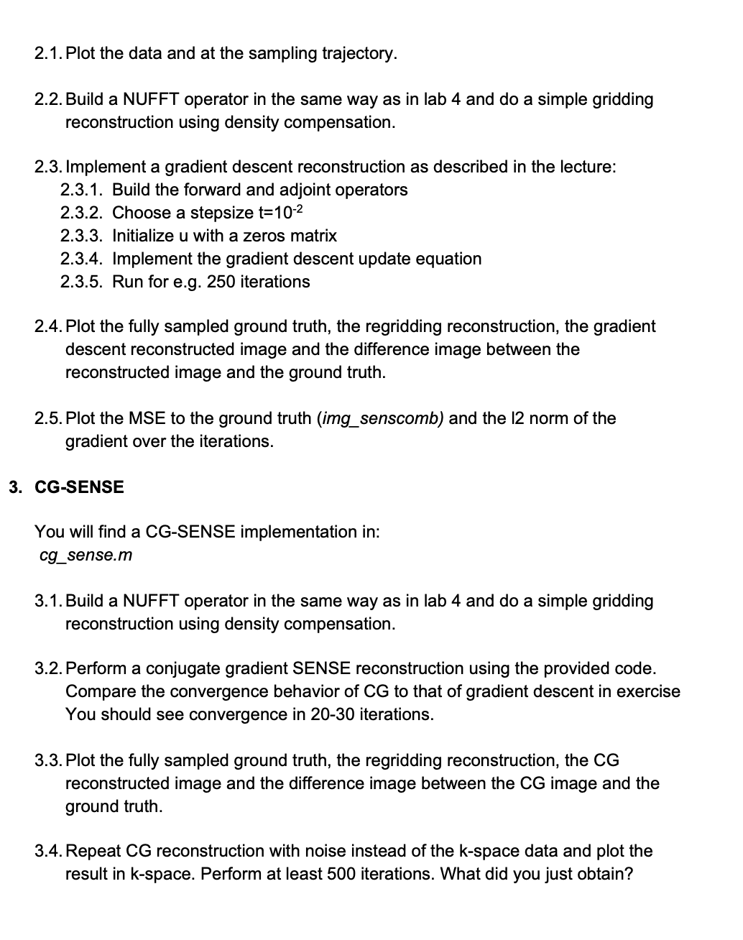
Exercise

